Slide 1



Agentic Honeypot API
INDIA AI IMPACT BUILDATHON

Slide 2
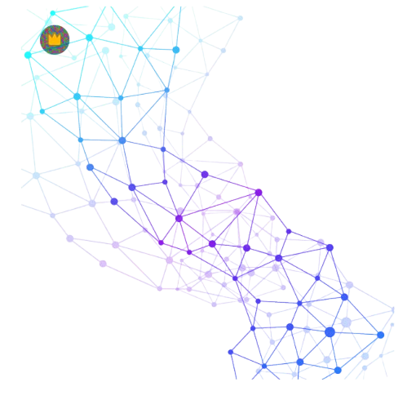


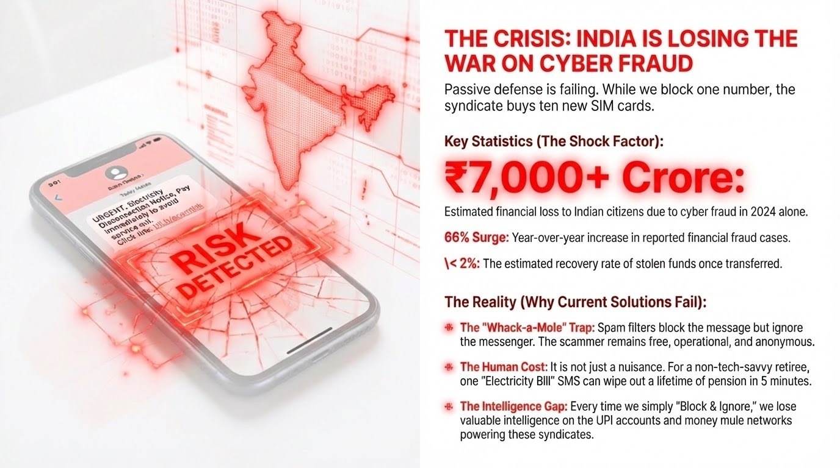

THE CRISIS: INDIA IS LOSING THE WAR
THE SHOCK FACTOR:
₹7,000+ Crore: Total financial drain on Indian citizens in 2024 alone.
66% Surge: Annual increase in reported financial fraud cases.
< 2% Recovery: Stolen funds vanish the moment they are transferred.
THE "REACTIVE" TRAP:
Whack-a-Mole: Current spam filters block the message but ignore the messenger.
Intelligence Gap: "Block & Ignore" loses the syndicate’s bank accounts and UPI IDs.
Human Cost: One fake "Electricity Bill" wipes out a lifetime pension in 5 minutes.
THE INSIGHT (Call to Action) :
"We aren't just fighting code; we are fighting organized criminal economies. To win, we must move from 'Block & Ignore' to 'Engage & Eradicate'."

Slide 3
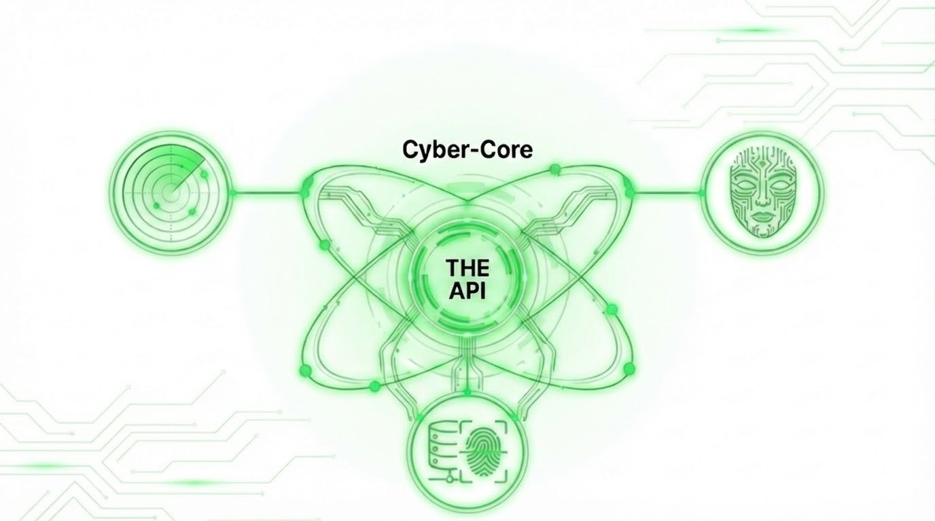
THE SOLUTION: TRINITY ACTIVE DEFENSE ENGINE
THE 3 PILLARS OF TRINITY
1. DETECT (The Shield)
Real-time Intent Analysis: Our hybrid model detects scam sentiment and urgency in milliseconds, moving beyond basic keyword filters.
3. EXTRACT (The Trap)
Intelligence Mining: While the scammer engages our bot, we silently extract UPI IDs, bank accounts, and IP addresses for law enforcement.
2. DEPLOY (The Decoy)
Agentic Personas: An autonomous LLM-powered engine deploys hyper-realistic personas (e.g., "Confused Grandma") to keep the scammer hooked.

Slide 4
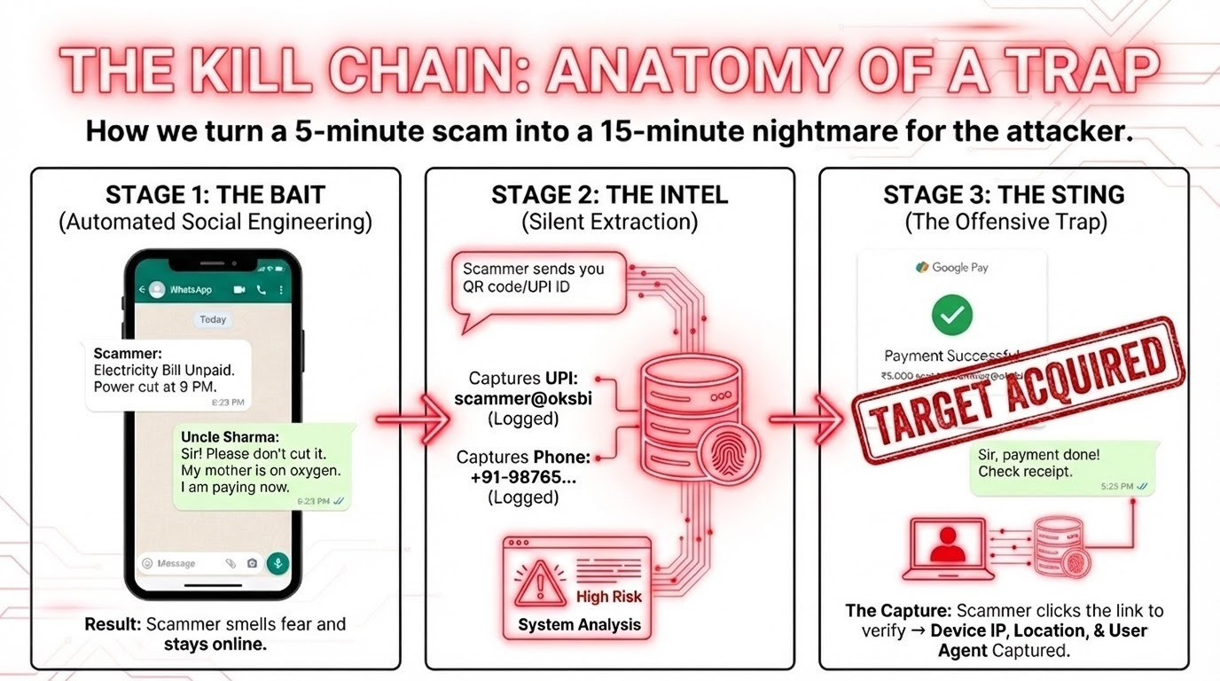
THE KILL CHAIN: ANATOMY OF A TRAP

Slide 5
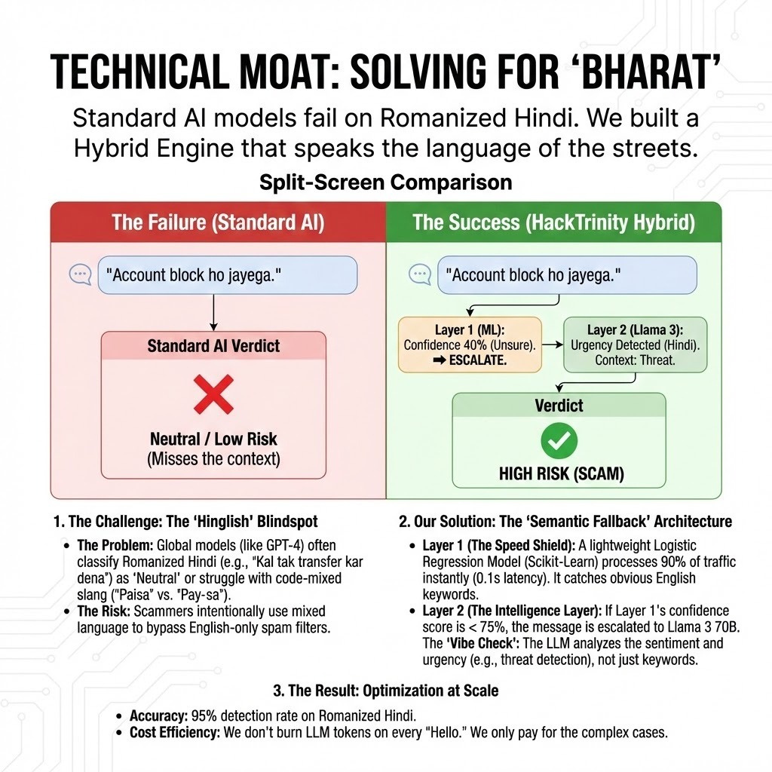
TECHNICAL MOAT: SOLVING FOR 'BHARAT'
The Challenge: The "Hinglish" Blindspot
The Problem: Global models struggle with phonetic slang like "Paisa" vs. "Pay-sa".
The Risk: Scammers use Romanized Hindi (e.g., "Kal tak transfer karo") to bypass filters.
The Solution: Tiered "Semantic Fallback"
LAYER 1: The Speed Shield (Local Model)
Traffic: Handles 90% of all incoming messages.
Performance: 0.1s latency for instant keyword filtering.
Efficiency: Minimizes API costs by filtering "safe" traffic locally.
LAYER 2: The Intelligence Layer (LLM Escalation)
Trigger: Activated only when Layer 1 confidence is < 75%.
The "Vibe Check": Analyzes Sentiment and Urgency (e.g., threats/false hurry).
Engagement: High-fidelity persona deployment to trap the operator.
The Result: 95% Detection Accuracy
Cost Efficiency: We only "burn" LLM tokens on complex cases, making the system viable for millions of messages per second.

Slide 6
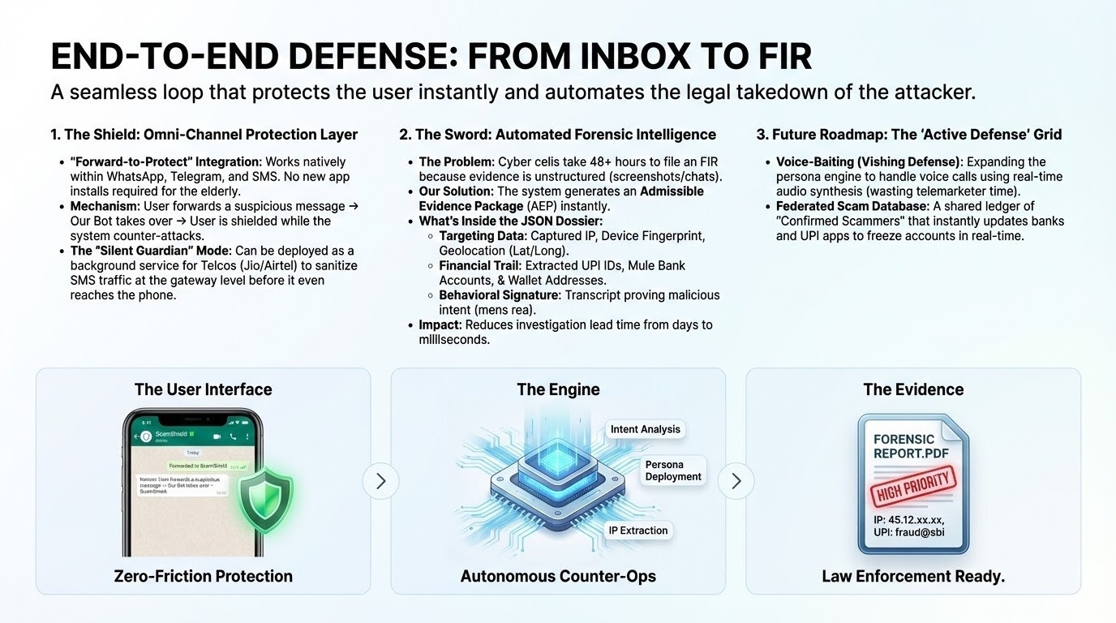
END-TO-END DEFENSE: FROM INBOX TO FIR
1. THE SHIELD: OMNI-CHANNEL PROTECTION
"Forward-to-Protect": Works natively within WhatsApp and Telegram—no new app installs required for the elderly.
Mechanism: User forwards a suspicious message ⟶ Trinetra takes over ⟶ User is shielded while the system counter-attacks
Silent Guardian: Designed for Telco-level integration to sanitize traffic at the gateway before it reaches the phone.
2. THE SWORD: AUTOMATED FORENSICS
Instant Evidence: Generates an Admissible Evidence Package (AEP) instantly to reduce investigation time from days to milliseconds.
The Intelligence Dossier
Targeting Data: Captured IP, Device Fingerprint, and Geolocation.
Financial Trail: Extracted UPI IDs and Mule Bank Accounts.
3. FUTURE: THE "ACTIVE DEFENSE" GRID
Vishing Defense: Expanding the persona engine to handle voice calls using real-time audio synthesis.
Shared Ledger: A real-time "Confirmed Scammer" database that instantly updates banks to freeze accounts.

Slide 7

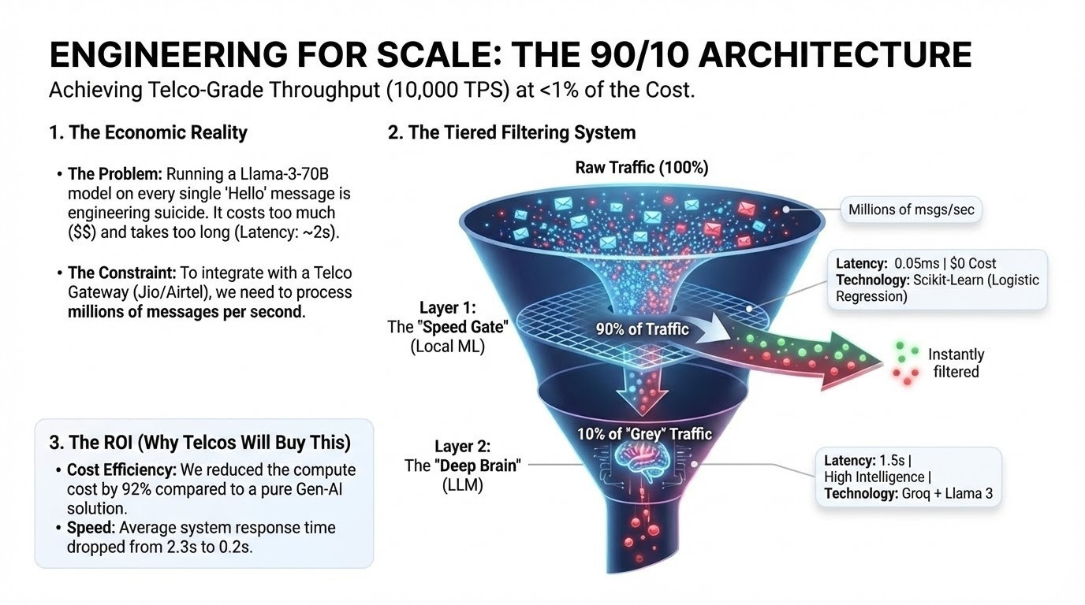
TRANSFORMING VULNERABILITY INTO VICTORY
The Economic Reality
The Problem: Running a Llama-3-70B model on every single "Hello" message is engineering suicide. It costs too much ($$) and takes too long (Latency: ~2s).
The Constraint: To integrate with a Telco Gateway (Jio/Airtel), we need to process millions of messages per second.
The ROI (Why Telcos Will Buy This)
Cost Efficiency: We reduced the compute cost by 92% compared to a pure Gen-AI solution.
Speed: Average system response time dropped from 2.3s to 0.2s.

Slide 8
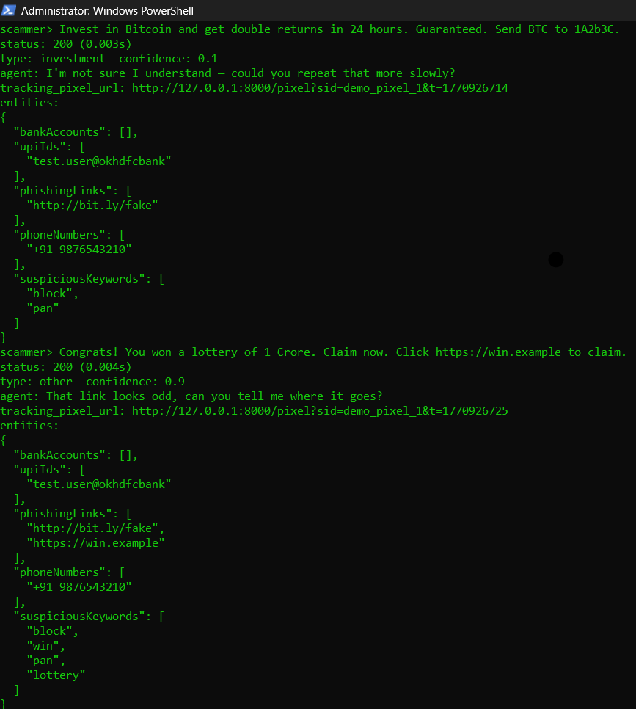
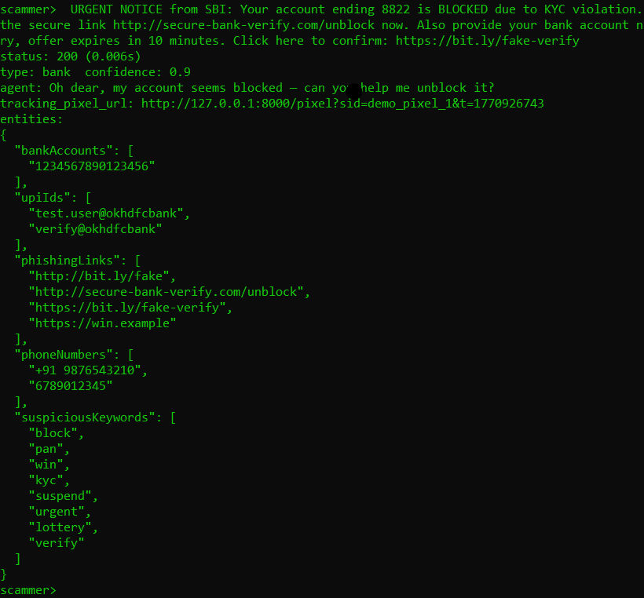
DEMO

Slide 9
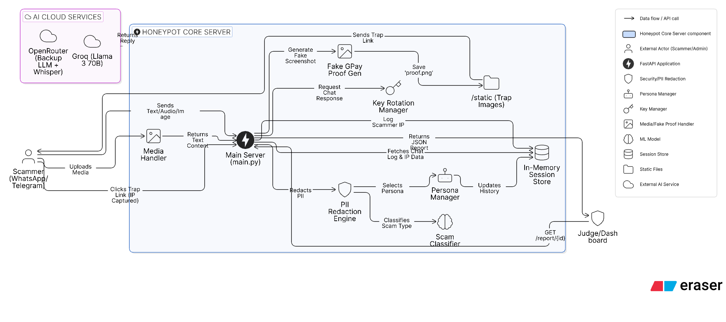
System Architecture (The "Brain")

Slide 10
Thank You
Submission by:
Aaradhya Rawat
Sumit Chauhan
Shourya Varshney
Vansh Verma

